Slide 1


Campaign Measurement Science – Robust Ancova
New Methodology Details
© 2021 Copyright dunnhumby / All rights reserved

Slide 2

Randomized Control Experiments in conjunction with ANCOVA is used for measuring incremental customer behaviour in many dunnhumby campaigns.
Randomized Control Experiments in conjunction with ANCOVA is used for measuring incremental customer behaviour in many dunnhumby campaigns.
This involves:
Randomly selecting test and control customers
Exposing test customers with the campaign
Post campaign measure customer behavior between test and control
Comparison includes:
  Estimating the campaign impact on test group (ex. incremental Spend Per Customer)
  Statistically validate the observed impact using t-test or ANCOVA
This involves:
Randomly selecting test and control customers
Exposing test customers with the campaign
Post campaign measure customer behavior between test and control
Comparison includes:
  Estimating the campaign impact on test group (ex. incremental Spend Per Customer)
  Statistically validate the observed impact using t-test or ANCOVA

Slide 3
Retrospective and Upfront modules for customer level campaigns
Upfront module : used when the test and control are matchable, and we just want to calculate uplift between the two groups.
Retrospective (matching) module : used when match between test and control has deteriorated beyond acceptable limits.
Match between test and control might deteriorate due to a number of reasons:
Fallow Period | There is generally a gap between control selection and when the campaign starts. This can be due to printing/mailing time, data lag, etc. The test and control which were matched in the targeting period may not remain similar in the fallow period.
Difference in targeting and outbound files | Sometimes the target file that contains the list of customers to be targeted, is subjected to some changes (customers might be removed which have incorrect address registered, customers might be added as VIP, etc). This may cause the match between test and control to no longer hold.
Control Redeemers | Some customers from the control might end up taking part in the marketing campaign. These customers must be excluded to avoid erroneous results. But exclusion of these customers may result in the match between test and control deteriorating.
No controls held out at the time of targeting | There are cases where we simply cannot hold out controls (in national marketing campaigns, targeting done on client’s side, etc). In these cases, we must take controls from the non-respondents / non-exposed.

Slide 4
Main modules in methodology
Input Creation
Pre Period Identification
Outlier Removal
Sample Size Selection
Uplift Calculation

Slide 5
Input Creation
Pre Period Identification
Sample Size Selection
Uplift Calculation
Outlier Removal
Type | Feature Name | Description | Comments
Campaign | Customer ID | Unique Customer Identifier | Necessary
Campaign | Test / Control Flag | Flag giving whether the customer is test or control | Necessary
Campaign Period | Campaign Sales | Campaign Period Sales | Necessary
Pre Period | Pre Sales 1 | Pre Period sales where pre period is of the same duration as the campaign period. | Necessary
Pre Period | Pre Sales 2 | Pre Period sales where pre period duration is 2 times the duration of the campaign period. | Necessary
Pre Period | Pre Sales 3 | Pre Period sales where pre period duration is 3 times the duration of the campaign period. | Necessary
Pre Period | Pre Sales 4 | Pre Period sales where pre period duration is 4 times the duration of the campaign period. | Necessary
Pre Period | Pre Visits 1 | Pre Period visits where pre period is of the same duration as the campaign period. | Optional
Pre Period | Pre Visits 2 | Pre Period visits where pre period duration is 2 times the duration of the campaign period. | Optional
Pre Period | Pre Visits 3 | Pre Period visits where pre period duration is 3 times the duration of the campaign period. | Optional
Pre Period | Pre Visits 4 | Pre Period visits where pre period duration is 4 times the duration of the campaign period. | Optional
Pre Period | Pre Units 1 | Pre Period Units where pre period is of the same duration as the campaign period. | Optional
Pre Period | Pre Units 2 | Pre Period Units where pre period duration is 2 times the duration of the campaign period. | Optional
Pre Period | Pre Units 3 | Pre Period Units where pre period duration is 3 times the duration of the campaign period. | Optional
Pre Period | Pre Units 4 | Pre Period Units where pre period duration is 4 times the duration of the campaign period. | Optional
Pre Period | Customer Loyalty | Customer's Loyalty at the end of the pre period | Optional
Pre Period | Customer LTL | Customer's long term loyalty at the end of the pre period | Optional
Pre Period | Customer Price Sensitivity | Customer's Price Sensitivity at the end of the pre period | Optional
Pre Period | Customer Lifestage | Customer's Lifestage at the end of the pre period | Optional
Pre Period | Customer Lifestyle | Customer's Lifestyle at the end of the pre period | Optional
Pre Period | Customer's prefered store region | Customer's prefered store region at the end of the pre period | Optional
Pre Period | Customer's prefered store format | Customer's prefered store format at the end of the pre period | Optional
Pre Period | Customer's prefered store sales | Customer's prefered store sales in last 13 weeks | Optional
Pre Period | No. of Contacts (campaign type) | Number of contacts through a similar campaign in last 13 weeks | Optional
Pre Period | No. of Redemptions (campaign type) | Number redemptions a coupon from a similar campaign in last 13 weeks | Optional
Pre Period | No. of Contacts (overall) | Number of contacts in last 13 weeks | Optional
Pre Period | No. of Redemptions (overall) | Number of redemptions a coupon from in last 13 weeks | Optional
* Apart from these features, any features used to define eligibility of selecting the customer base for the given campaign should also be included

Slide 6
Input Creation
Pre Period Identification
Sample Size Selection
Uplift Calculation
Outlier Removal
Pre Sales 1
Pre Sales 2
Pre Period | Correlation with Campaign Sales
Pre Sales 1 | 0.3857
Pre Sales 2 | 0.4299
Pre Sales 3 | 0.4779
Pre Sales 4 | 0.4532
Set of Different
Pre Period
Features
Pre Sales 3
Pre Sales 4
Correlation Calculation
(Using unexposed base)
Pre Sales 3
Best Pre Period
identified
Campaign Period
Feature to be
used for uplift
calculation
This module calculates Pearson correlation coefficient between each pre period feature given with the campaign period feature for the unexposed eligible customers. The variable with the highest correlation is the pre period chosen to check match and calculate uplift. This step is preferred unless the pre period is pre decided.
Campaign Sales

Slide 7
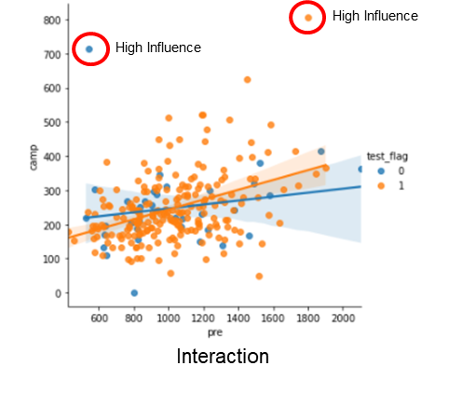
Outlier effect
Presence of outliers can significantly impact the regression line

Slide 8
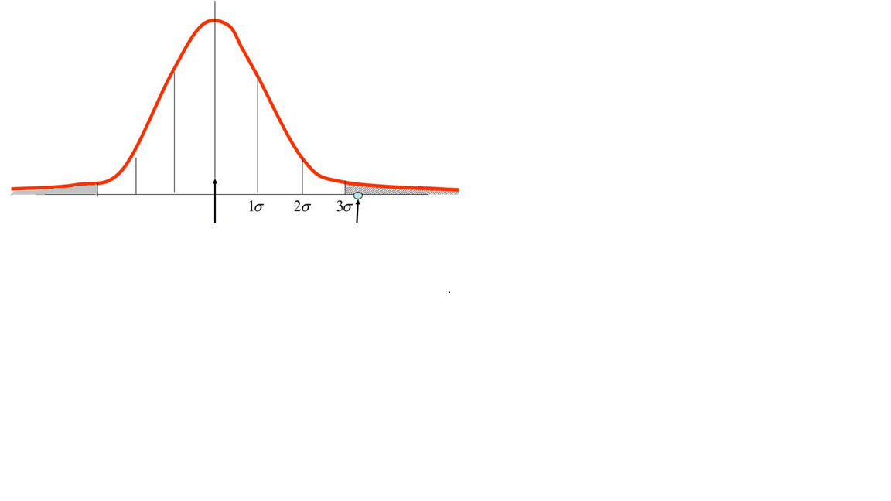

Input Creation
Pre Period Identification
Sample Size Selection
Uplift Calculation
Outlier Removal
This step removes the outlier customers, that may impact the final results severely, if included
The outliers are removed for both test and control customers, based on pre period and post period variables
We do log transformation of data (on the variable, for which outliers are detected ) to make skewed data normally distributed.
Remove outliers which are beyond 3-sigma limits.
3$σ$
Suspected outlier
mean
Suspected outlier

Slide 9

Clustering for Retrospective Module
Control selection : Retrospective Module
Selecting feature variables for clustering
Clustering the test and unexposed pool using K-means

Slide 10
Matching Feature Selection Using Random Forest
Set of Pre-Period numeric
Features
Pre Sales 1
Pre Sales 2
Pre Visits 1
…
Pre Sales 3
Pre Sales 4
Pre Visits 2
…
Training Regression
Model
(Using unexposed base)
Scoring All Customers
Loyalty
…
Set of Pre-Period categorical
Features
Campaign Period Sales Prediction (had the campaign not occurred)
Price Sensitivity
…
Campaign Period
Feature to be used as target variable
Campaign Sales
This module trains a random forest regression model on the set of unexposed customers using all pre period features as independent and campaign period sales as dependent variable. It then scores all the customers(test+control). The score (prediction) along with the pre_period KPI is used for matching.

Slide 11
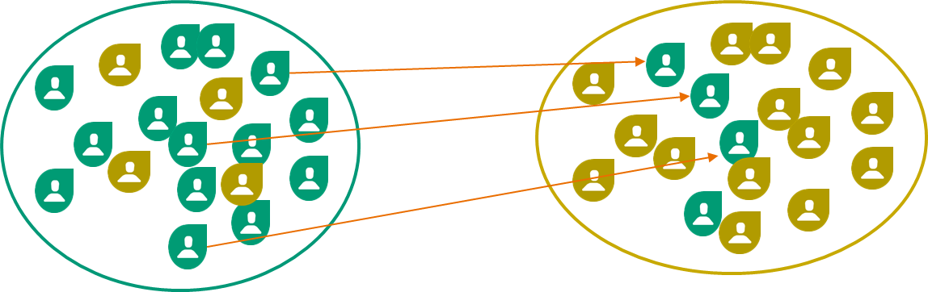
Clustering Test and Control Customers Using K-Means
Micro clusters using K-Means
Clustering
Assign
control to
the clusters
& remove
outliers
Post
Filtering
Initial pool
of test customers
Clustered test
customers
Assigning the control customers
to the clusters and remove
the control that are too far
Final clusters of
test and control
Customers post
outlier removal

Slide 12
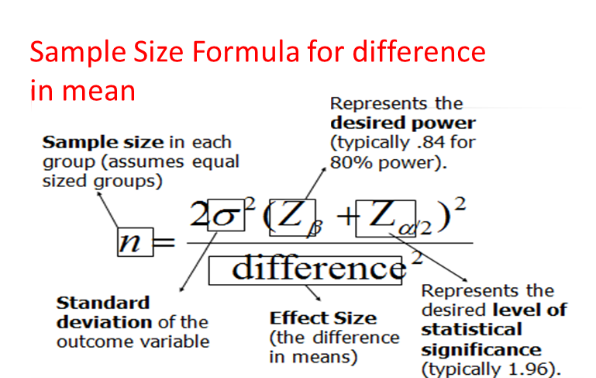
Input Creation
Pre Period Identification
Outlier Removal
Sample Size Selection
Uplift Calculation
ANCOVA is more efficient than simple two sample t-test(or z-test)
It provides the same Statistical Power with reduced Sample Size
Sample Size required by ANCOVA = (1- Corr²) * n
where: n = Sample Size identified for two sample t-test/ z-test
Corr = Correlation between Pre-Period vs. Campaign-Period
Customer Spend.
We calculate the sample size for 80% power
Using the above formula, we get the minimum test and control samples required to detect the incremental effect.
These sample sizes are used to resample the test and control customers N times iteratively for creating a more robust model.

Slide 13
ANCOVA MODEL
Basic Ancova Model
Ancova Model with Interaction
Ancova model with extra-covariate segments, and it’s interaction terms

Slide 14
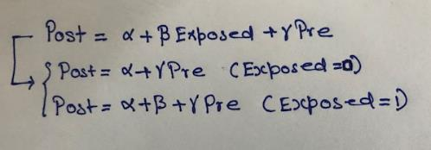
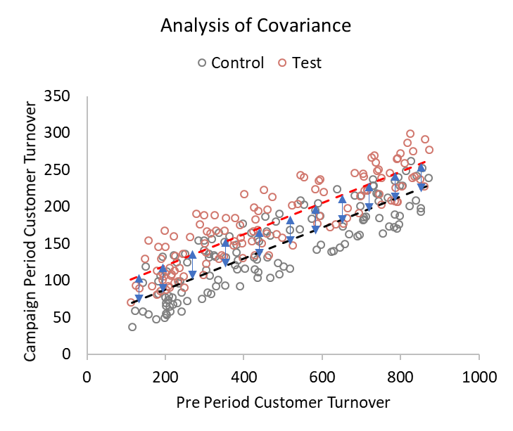
Basic Ancova Model
Grey Regression Line
Red Regression Line

Slide 15
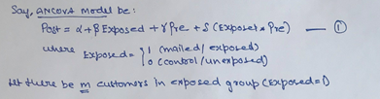
ANCOVA Model with Interaction
We used this model to estimate the expected uplift for sample size calculator
Grey Regression Line
Red Regression Line
Without Interaction
With Interaction
Post Spend
Post Spend
Pre Spend
Pre Spend

Slide 16

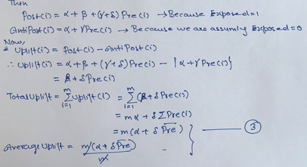
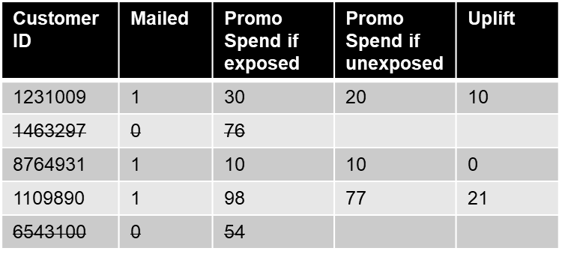
Uplift from ANCOVA Model
We will observe same uplift for all mailed customers if interaction term is insignificant

Slide 17
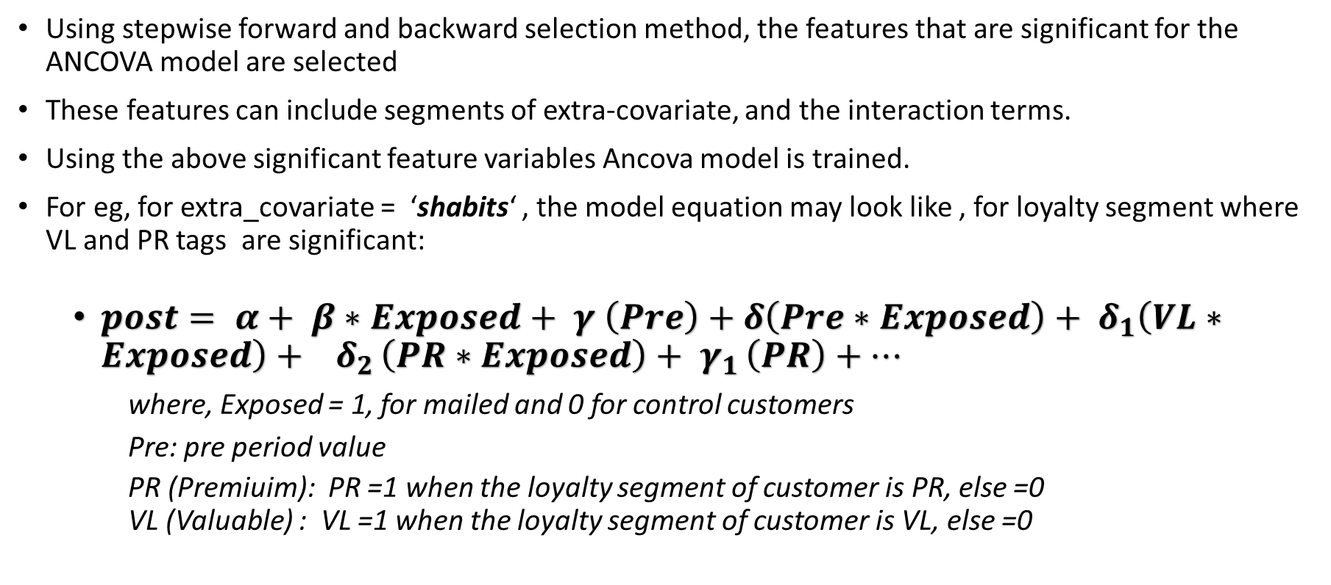
ANCOVA Model with Extra-covariates
Using stepwise forward and backward selection method, the features that are significant for the ANCOVA model are selected
These features can include segments of extra-covariate, and the interaction terms.
Using the above significant feature variables Ancova model is trained.
For eg, for extra_covariate = ‘shabits‘ , the model equation may look like , for loyalty segment where VL and PR tags are significant:
  $post= α+ β∗Exposed+ γ \left(Pre\right)+δ\left(Pre∗Exposed\right)+ δ_{1}\left(VL∗Exposed\right)+ δ_{2 }\left(PR∗Exposed\right)+ γ_{1 }\left(PR\right)+…$
  where, Exposed = 1, for mailed and 0 for control customers
  Pre: pre period value
  PR (Premiuim): PR =1 when the loyalty segment of customer is PR, else =0
  VL (Valuable) : VL =1 when the loyalty segment of customer is VL, else =0

Slide 18
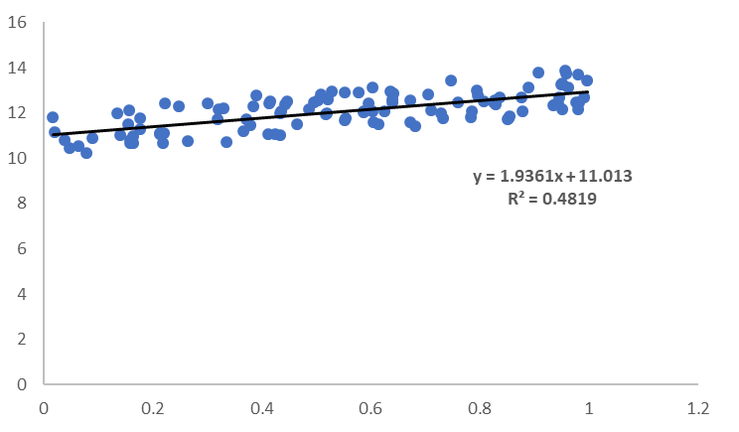
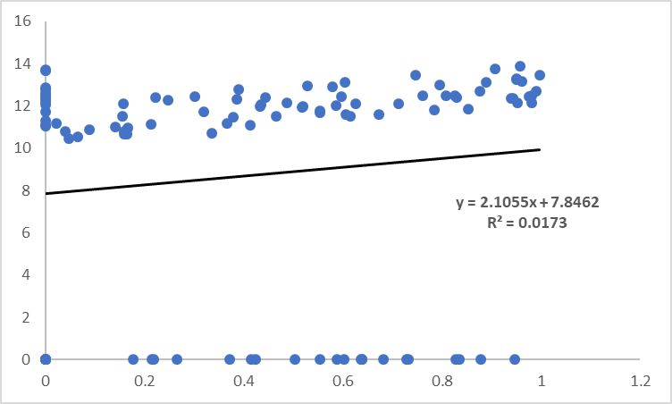
Effect of too many new-buyers on ANCOVA
Presence of too many non-buyers impact the model parameters
Measuring new buyers through ANCOVA is not a good idea
ANCOVA model is used for scoring existing buyers
ANOVA model is used for scoring new buyers
The number of customers with negative uplift has reduced significantly!

Slide 19

Input Creation
Pre Period Identification
Outlier Removal
Sample Size Selection
Uplift Calculation
Once we have the sample size required for test and control, we resample the customers
Then train two models: (a) ANCOVA: to predict the uplift for existing buyers.
(b) ANOVA: to predict uplift model for new buyers
Sampling and Uplift Calculation
Final Sampling corresponding to iteration with mean uplift
Exposed Customers
Uplift Calculation enhanced ANCOVA
Iteration1 Iteration2 Iteration3 Iteration4
…
Iteration100
Unexposed Customers
Merge the results
Resampled (Matched) Test and Control
Existing Buyers
(Pre sales >0)
Uplift Calculation enhanced ANOVA
New Buyers
(Pre sales = 0)

Slide 20
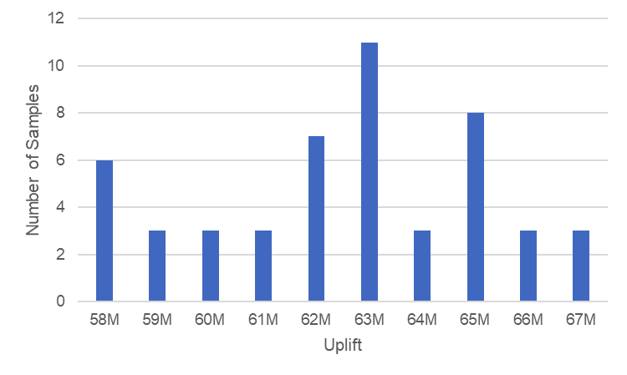
Input Creation
Pre Period Identification
Outlier Removal
Sample Size Selection
Uplift Calculation
After merging the uplift results for ANOVA and ANCOVA, identify seed with uplift closest to mean uplift in above 100 iterations.
Separate existing buyers and new-buyers in pre period for sampled customers (using seed identified above).
Run ANOVA and ANCOVA for new-buyers and existing buyers respectively and append ANOVA and ANCOVA uplift for sampled mailed customers.
Identify remaining mailed customers (non-sampled) and score these customers as per the ANOVA/ANCOVA model identified above.

Slide 21
Input Creation
Pre Period Identification
Sample Size Selection
Uplift Calculation
Outlier Removal
Sample customer output
All the outlier customers are flagged.
Individual customer uplift is returned, along with total uplift, sum of (individual customer uplift).
Card Code | Uplift | Campaign Sales | mc | Loyalty
1002 | 1,635 | 7,975 | M | VL
1070 | 1,270 | 7,401 | M | VL
1055 | 1,241 | 36,808 | M | PR
1062 | 993 | 6,453 | M | VL
1087 | 1,332 | 19,381 | M | VL
1042 | 1,295 | 59,000 | M | PR
1032 | 1,465 | 12,107 | M | VL
1019 | 795 | 28,665 | M | PR
1041 | 1,667 | 30,067 | M | PO
1010 | 1,420 | 6,438 | M | PO
1017 | 1,172 | 38,102 | M | VL
1018 | 1,558 | 4,490 | M | VL
1049 | 1,061 | 30,966 | M | PR
1028 | 1,458 | 28,111 | M | PO
1056 | 1,546 | 18,913 | M | PR
1004 | 1,121 | 14,836 | M | PR
1005 | 907 | 46,371 | M | PR
1057 | 1,172 | 25,044 | M | PR
1069 | 1,337 | 9,414 | M | VL
1003 | 960 | 29,750 | M | PR
… | … | … | … | …
Sample aggregate output
Mean Uplift | Total uplift | Uplift % | Test sample size | Control sample size | P-val existing buyers model | P-val new buyers model
3.09 | 313,138.14 | 0.328013 | 3,232 | 3,232 | 0.00 | 0.034

Slide 22
Why Robust Ancova?
Less variation in Uplift number for similar campaigns
Reduced execution time
Increased number of cases where significant positive lift is detected

